Slide 1
ParaView-Blender-USDZ 1/28 Progress
By: Josef Mate Brozovich

Slide 2
Last Week
Loaded VTK files in ParaView
Exported ParaView files to Stanford (.ply)
Imported files into blender
Added color back and connected the PLY files in a time series
Exported files as glb
Wrote up all steps, so easily reproduced

Slide 3
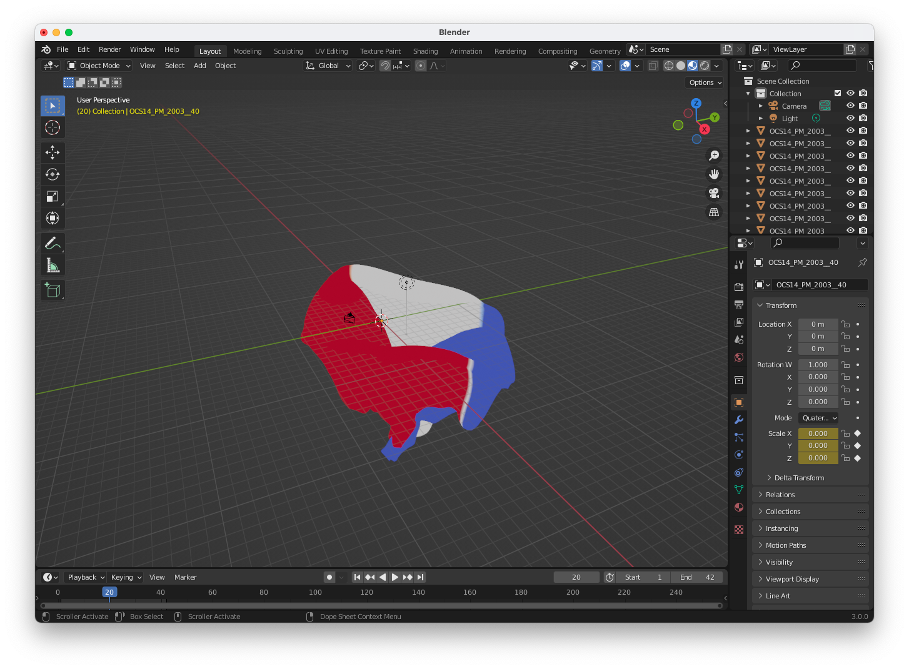
Result

Slide 4
Next Week
Export file to USDZ
Learn how to use USDZ Stich Clips
Utilize Google model viewer tool
Create Gantt Chart with correct format

